Slide 1
Ethical Hacking Training
-

Slide 2
Agenda
Hacking Short Intro
Impacts of hacking
Skills required
Types of Hacker
Phases of Hacking
Skills required
Notes:
l

Slide 3
Hacking short Intro
Ethical hacking refers to the act of locating weaknesses and vulnerabilities of computer and information systems by duplicating the intent and actions of malicious hackers.
Ethical hacking is also known as penetration testing, intrusion testing, or red teaming
The use of learning ethical hacking you will gain System knowledge and you can apply that to Good purpose.
Note: Stay Legal & use your skills for Good Purpose.

Slide 4
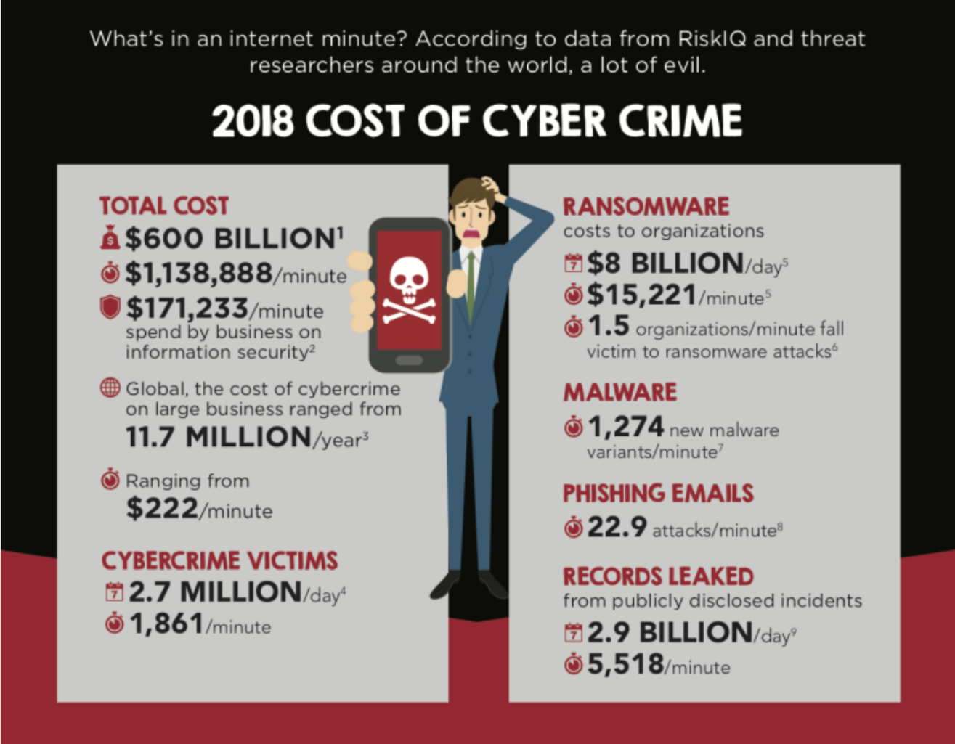
Impacts of hacking

Slide 5
Skills Required

Slide 6
Types of Hacker’s
White Hat
Black Hat
Grey Hat
Script kiddies
State sponsored
Cyber Terrorists
Suicide hacker
And more…

Slide 7
Phases of Hacking
Reconnaissance [ foot printing ]
Scanning [ enumeration also covered]
Gaining the access
Maintaining the access
Clearing the tracks

Slide 8
RECONNAISANNCE

Slide 9
Reconnaissance:
“Give me six hours to chop down a tree and I will spend the first four sharpening the axe”
Abraham Lincoln
Process of collecting or gathering an information about target as much as possible
Why it’s important:
Reduce the scope
Find out the attack vector

Slide 10
Types of Recon [Reconnaissance]
Active
interacting with target, to collecting the information
Ex: port scanning, ping
Passive
Without interaction, to collecting the information about target.
Ex: job site, search engine, social networks

Slide 11
IP Address & DNS information
Find out the target IP address and DNS information
Open source tool:
dnsenum [ preinstalled in kali ]
Tool:
whois
Ping utility
Whois

Slide 12
Google Dorks
Available: https://www.exploit-db.com/google-hacking-database
search string that uses advanced search operators to find information
Sample query:
Intext:”index of /”
Inurl:admin
Site:google.com
Ext:*.pdf

Slide 13

Way back Machine
digital archive of the World Wide Web and other information on the Internet.
Tips:
Analyse source code, you might seen what kind of feature they upgraded.
Available:
https://web.archive.org/
https://archive.org/web/

Slide 14
Net craft
Find out the OS details and more..
Available:
https://searchdns.netcraft.com/

Slide 15
Subdomain finder
Gathering the subdomain list of target domain
Mostly vulnerability present in subdomain [ less travelled path ]
Open source tool:
https://github.com/aboul3la/Sublist3r

Slide 16
Shodan.io
Search engine for security
Exist the vulnerability details about target.
Link:
https://www.shodan.io/
Similar website :
censys.io
https://censys.io

Slide 17
Misc
Pipl.com
Pipl is the place to find the person behind the email address, social username or phone number
Temporary mail
provides temporary, anonymous, free, secure, disposable email address. You can use on Facebook, twitter or Instagram for anonymously
Note:
A lot of open source tool’s available in internet.

Slide 18
SCANNING

Slide 19
Scanning
Set of procedure for identifying hosts, ports and services in a network.

Slide 20
Pre requisite
Below pre requisite knowledge are mandatory to performing scanning.
TCP/IP communication
TCP/IP Flags details
Ping command working flow

Slide 21
TCP/IP Communication

Slide 22
TCP/IP Flags

Slide 23
Custom packets by using flags

Slide 24
Scanning Methodology
Look for live ports
Look for open ports
Evade IDS
Banner Grabbing
Vulnerability scanning
Build Network diagrams
Use proxies
Pen testing reports

Slide 25
Live ports

Slide 26
Open ports

Slide 27
Evade IDS

Slide 28
Vulnerability scans

Slide 29
Banner Grabbing

Slide 30
Build Network Diagrams

Slide 31
Proxies

Slide 32
Scanning Report

